Slide 1

CEA MASLD Study Updates
=Done
=In Progress
Base Case |  | Subgroups (Male, older, diabetic)
 | Collecting inputs |  | Deriving inputs for individual subgroups (male, >65 y/o, diabetic)
 | Running model verifications |  | Running model verifications
 | Base case analysis |  | Base case analysis
 | One-way sensitivity analysis |  | One-way sensitivity analysis
 | Threshold + probabilistic sensitivity analysis |  | Threshold + probabilistic sensitivity analysis
 |  |  | Choosing combined subgroups and deriving inputs
 |  |  | Sensitivity analyses for combined subgroups
Completed:
Base case
Finalizing inputs
Running verifications
Base case analysis: ICER is $206K
One-way sensitivity analysis
Subgroups
Preparing inputs for male, >65 y/o, and diabetic subgroups (individually)
Preliminary analysis: we found that subgroup for >65y/o ICER meets $150K WTO threshold
Need to do:
Base case
Review the one-way sensitivity analysis and determine which inputs are the most important --> intuition for which subgroups would be cost-effective
Threshold + Probabilistic sensitivity analysis
Subgroups
Run base case analysis for each subgroup with most updated inputs
Derive inputs for combined subgroups and run base case analysis

Slide 2
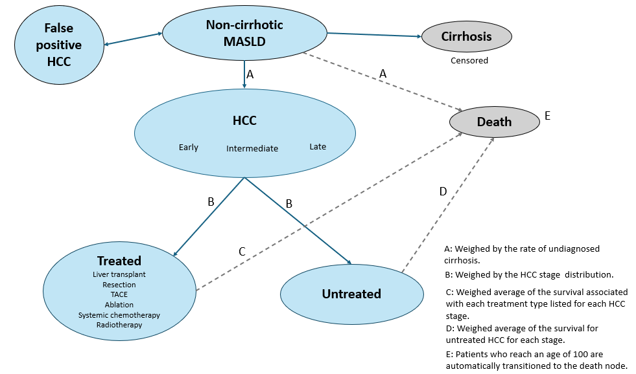
Model Overview

Slide 3
Base Case: Inputs
Parameter | Base Case and Range | Reference
Undiagnosed cirrhosis % | 24.2% (18.1%-30.2%) | Average of values from Walker 2016 (24.6%), Fujimoto 2008 (23.7%)
Screening adherence rate | 60% (45%-75%) | Singal 2024 (CEA study, used 60% as an estimate)
False positive HCC | 15% (7%-27%) | Colli 2021(meta analysis)
Transition probabilities
MASLD to cirrhosis | 1.085% (0.665%-1.506%) | Le 2024 (meta analysis)
Non-cirrhotic MASLD to HCC | 0.004% (0.004%-0.006%) | Huang 2024 (Optum study, we took the data for patients who had PLT> 150,000/µL to make sure pts are truly non-cirrhotic)
Cirrhotic MASLD to HCC | 2.25% (2.08%-2.43%) | Behari 2023 (Cohort study from UPMC health network. 10,305 cirrhosis patients included)

Slide 4
HCC Stage Upon Diagnosis
 | % Value | Reference
Without HCC screening (control)
% Early stage | 45.7% | Daher 2024
% Intermediate stage | 23.0%
% Late stage | 31.3%
With HCC screening (intervention)
% Early stage | 70.7% | Daher 2024
% Intermediate stage | 15.6%
% Late stage | 13.7%
HCC treatment rate (taken from SEER Medicare, using weighed average of treatment data from cohort of non-cirrhotic MASLD and cirrhotic MASLD patients)
HCC stage upon diagnosis | Treated | Untreated
Early | 53.3% | 46.7%
Intermediate | 53.3% | 46.7%
Late | 38.9% | 61.1%
Weighed across all stages (control arm) | 48.8% | 51.2%
Weighed across all stages (intervention arm) | 50.3% | 49.7%
Notes:
No screening isn't truly non screening. Need to look into HCC stage distribution again.
Possibly use reasonable range

Slide 5
Annual Death Probability – by HCC stage (calculated using SEER Medicare)
To find the weighed annual death probability:
Found annual death rate for each treatment type (ablation, radiotherapy, resection, systemic, TACE, transplant) from literature or SEER Medicare.
Found weighed average annual death % for each HCC stage by weighing the death % of each treatment type by the distribution of treatment received.
Further weighed the weighed average death % for each HCC stage by the HCC stage distribution.
HCC stage upon diagnosis | Treated | Untreated
Early | 20.1% | 35.7%
Intermediate | 36.9% | 63.2%
Late | 79.2% | 87.2%
Weighed across all stages (control arm) | 39.1% | 60.7%
Weighed across all stages (intervention arm) | 32.9% | 53.6%

Slide 6
Annual Death Probability
Parameter | Base Case and Range | Reference
Non-cirrhotic MASLD to death | 0.175% (0.058%-0.291%) (liver-related death) | Younossi 2023 (meta analysis)
Compensated cirrhosis to death | 1.7% (1.3-2.1) (liver-related death) | Wang 2023 (population based cohort study in Canada)
To get transition probability from MASLD to death:
Weighed the non-cirrhotic MASLD death % and compensated cirrhosis death % by the undiagnosed cirrhosis rate.
Added the weighed average from above to the age-dependent annual death % obtained from the Actuarial Life Tables provided by the Social Security

Slide 7
Health State Utilities
Parameter | Base Case and Range | Reference
Non-cirrhotic MASLD | 0.85 (0.64-1.06) | Ock 2017 (Population based study in Korea)
Compensated cirrhosis (to account for undiagnosed cirrhosis) | 0.78 (0.71-0.89) | Singal 2024 (CEA study)
False positive HCC | Same as utility of MASLD (assume no significant decrease in utility)
Early stage HCC | 0.72 (0.62–0.82) | Singal 2024 (CEA study)
Intermediate stage HCC | 0.69 (0.62-0.78) | Singal 2024 (CEA study)
Late stage HCC | 0.40 (0.30-0.50) | Ock 2017 (Population based study in Korea)

Slide 8
Costs
Parameter | Base Case and Range (2025 USD) | Reference
Semiannual US+AFP Screening | $363 ($272-454) | Medicare fee schedule
CT/MRI to confirm HCC diagnosis | $630 ($473-$788) | Medicare fee schedule
Repeat CT/MRI for false positive HCC | $1050 ($788-$1313) | Medicare fee schedule
Medical care of patients with non-cirrhotic MASLD | $4395 ($3296-$5494) | Younossi 2023 (economic modelling study)
Early stage HCC (Treated) | $63255 ($33875 - $117193) | Karim 2023 (economic analysis using SEER)
Early stage HCC (Untreated) | $47,151 (43,541-50,843) | Shaya 2013 (economic analysis using SEER)
Intermediate stage HCC (Treated) | $ 118,753 (54,307-211,436) | Tapper 2016 (cohort study)
Intermediate stage HCC (Untreated) | $51,961 (44,479-60,593) | Shaya 2013 (economic analysis using SEER)
Late stage HCC (Treated) | $105,595 ($45,639- $144,868) | Tapper 2016(cohort study)
Late stage HCC (Untreated) | $78,547 (68,621-91,278) | Shaya 2013 (economic analysis using SEER)

Slide 9
Base Case: Model Verification
Checked node to node transitions graphically
Checked patient outcomes
Checked costs and utilities

Slide 10
Patient outcomes
 | Control | Intervention
Total % Developed HCC | 11.77% | 11.77%
Total % Developed Cirrhosis | 23.38% | 23.38%
10-Year HCC rate | 4.77% | 4.77%
10-Year Cirrhosis rate | 9.44% | 9.44%
Avg. Age of Developing HCC | 63.59 | 63.59
Avg. Age of Developing Cirrhosis | 63.75 | 63.75
Avg. Death Age from MASLD | 77.11 | 77.11
Mean Survival years for HCC | 3.07 | 3.44
Median Survival years for HCC | 2 | 3
5 Year HCC Survival rate | 25.66% | 32.76%

Slide 11
Checking costs and utilities
 | Control | Intervention
Average Costs Per Patient
Total costs | $74,920 | $79,818
Total costs for pts who developed HCC | $146,542 | $156,488
Total MASLD costs | $63,740 | $67,855
Total False Positive costs | 0 | $6,327
Total Treated HCC costs | $93,272 | $102,502
Total Untreated HCC costs | $90,330 | $94,366
Average Utilities Per Patient
Total utilities | 12.18 | 12.20
Total utilities for pts who developed HCC | 10.92 | 11.12
ICER | $206,703.38

Slide 12
Base Case: One-Way Sensitivity Analysis

Slide 13
Subgroup: Deriving Inputs
Male, >60-65 y/o, diabetic
Changed the following inputs
Undiagnosed cirrhosis rate
Non-cirrhotic MASLD to HCC
Cirrhotic MASLD to HCC
MASLD to cirrhosis
Age-adjusted death rate in MASLD node
Found % increase or decrease in the above data found in literature and applied that % change to our base case value

Slide 14
Subgroup inputs that are different from base case values
Parameter | Base Case | Male | >60-65 y/o | Diabetic
Undiagnosed cirrhosis % | 24.2% (18.1%-30.2%) | 33.3% (25.0%-41.6%) Fujimoto 2008 | 40.3% (30.2%-50.4%) Walker 2016 | Assume same as base case
MASLD to cirrhosis | 1.085% (0.665%-1.506%) | 1.33% (0.818%- 1.85%) Yeoh 2024 | 0.996% (0.611%-1.38%) Yeoh 2024 | 0.933% (0.572%-1.295%) Yeoh 2024
Non-cirrhotic MASLD to HCC | 0.004% (0.004%-0.006%) | 0.006% (0.006%-0.009%) Kanwal 2018 | 0.02% (0.02%-0.02%) Kanwal 2018 | 0.007% (0.007%-0.010%) Kanwal 2018
Cirrhotic MASLD to HCC | 2.25% (2.08%-2.43%) | 3.92% (3.63%-4.24%) Kanwal 2018 | 2.94% (2.72%-3.18%) Kanwal 2018 | 2.84% (2.63%-3.07%) Kanwal 2018
Other |  |  |  | Adjusted age-dependent death % from MASLD to account for increased mortality due to diabetes

Slide 15
Subgroup: Model Verification
 | Base Case |  | Male |  | >60-65 y/o |  | Diabetic
 | Control | Intervention | Control | Intervention | Control | Intervention | Control | Intervention
Total % Developed HCC | 11.77% | 11.77% | 22.99% | 22.99% | 15.14% | 15.14% | 9.59% | 9.59%
Total % Developed Cirrhosis | 23.38% | 23.38% | 23.39% | 23.39% | 12.66% | 12.66% | 12.82% | 12.82%
10-Year HCC rate | 4.77% | 4.77% | 10.79% | 10.79% | 9.31% | 9.31% | 5.34% | 5.34%
10-Year Cirrhosis rate | 9.44% | 9.44% | 10.87% | 10.87% | 7.74% | 7.74% | 7.11% | 7.11%
Avg. Age of Developing HCC | 63.59 | 63.59 | 61.93 | 61.93 | 76.96 | 76.96 | 57.88 | 57.88
Avg. Age of Developing Cirrhosis | 63.75 | 63.75 | 62.06 | 62.06 | 77.05 | 77.05 | 58.08 | 58.08
Avg. Death Age from MASLD | 77.11 | 77.11 | 73.95 | 73.95 | 83.09 | 83.09 | 66.46 | 66.46
Mean Survival years for HCC | 3.07 | 3.44 | 3.10 | 3.46 | 3.09 | 3.45 | 3.11 | 3.47
Median Survival years for HCC | 2 | 3 | 2 | 3 | 2 | 3 | 3 | 3
5 Year HCC Survival rate | 25.66% | 32.76% | 26.19% | 33.58% | 26.14% | 33.36% | 26.28% | 33.42%
Notes:
HCC survival increases for subgroups bc higher HCC probability, so patients get HCC earlier. After they get HCC their survival only depends on HCC survival probability and also once they hit 100 years, will die.

Slide 16
 | Base Case |  | Male |  | >60-65 y/o |  | Diabetic
 | Control | Intervention | Control | Intervention | Control | Intervention | Control | Intervention
Average Costs Per Patient
Total costs | $74,920 | $79,818 | $77,719 | $82,801 | $60,836 | $64,780 | $55,751 | $59,337
Total costs for pts who developed HCC | $146,542 | $156,488 | $147,028 | $156,796 | $146,775 | $156,344 | $147,279 | $156,631
Total MASLD costs | $63,740 | $67,855 | $54,605 | $58,132 | $43,937 | $46,776 | $45,487 | $48,425
Total False Positive costs | 0 | $6,327 | 0 | $5,430 | 0 | $4,374 | 0 | $4,526
Total Treated HCC costs | $93,272 | $102,502 | $98,374 | $108,557 | $110,713 | $121,654 | $104,928 | $114,688
Total Untreated HCC costs | $90,330 | $94,366 | $95,798 | $98,963 | $105,301 | $108,932 | $101,933 | $105,607
Average Utilities Per Patient
Total utilities | 12.18 | 12.20 | 10.47 | 10.52 | 8.41 | 8.44 | 8.72 | 8.74
Total utilities for pts who developed HCC | 10.92 | 11.12 | 9.92 | 10.14 | 7.95 | 8.18 | 8.92 | 9.14
ICER | $206,703 |  | $104,376 |  | $112,545 |  | $170,700
Notes:
For hcc stage distribution, use JCG paper. This paper is consistent vs. Inconsistent screening (not truly no surveillance). Use their reported data and extrapolate for truly no screening.
45% early is for inconsistent screening.
Consistent screening, inconsistent, then no screening (estimate: 30% early, sensitivity analysis of 15%)

Slide 17

Next Steps
From TreeAge Website:
Derive subgroup inputs
Use HRs instead? Could we apply multiple HRs to derive combined subgroup inputs?
Sensitivity Analyses for base case and subgroups

